Slide 1
CLOUD COMPUTING PRESENTATION
1

Slide 2
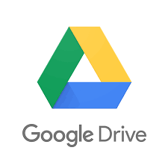




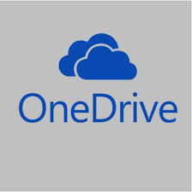
What is Cloud Computing?:
Cloud computing allows organizations to store, manage, and process data in remote data centers. Instead of having physical servers on-site, businesses access computing power through the internet, paying for only what they use.

Slide 3
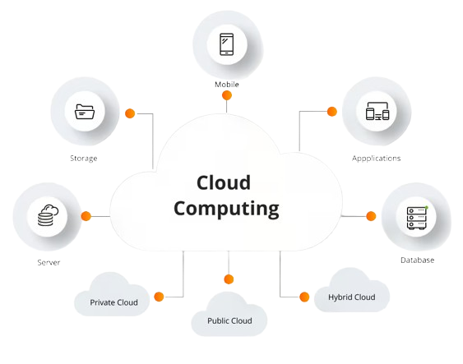
Mobile
Storage
Application
Server
Database

Slide 4
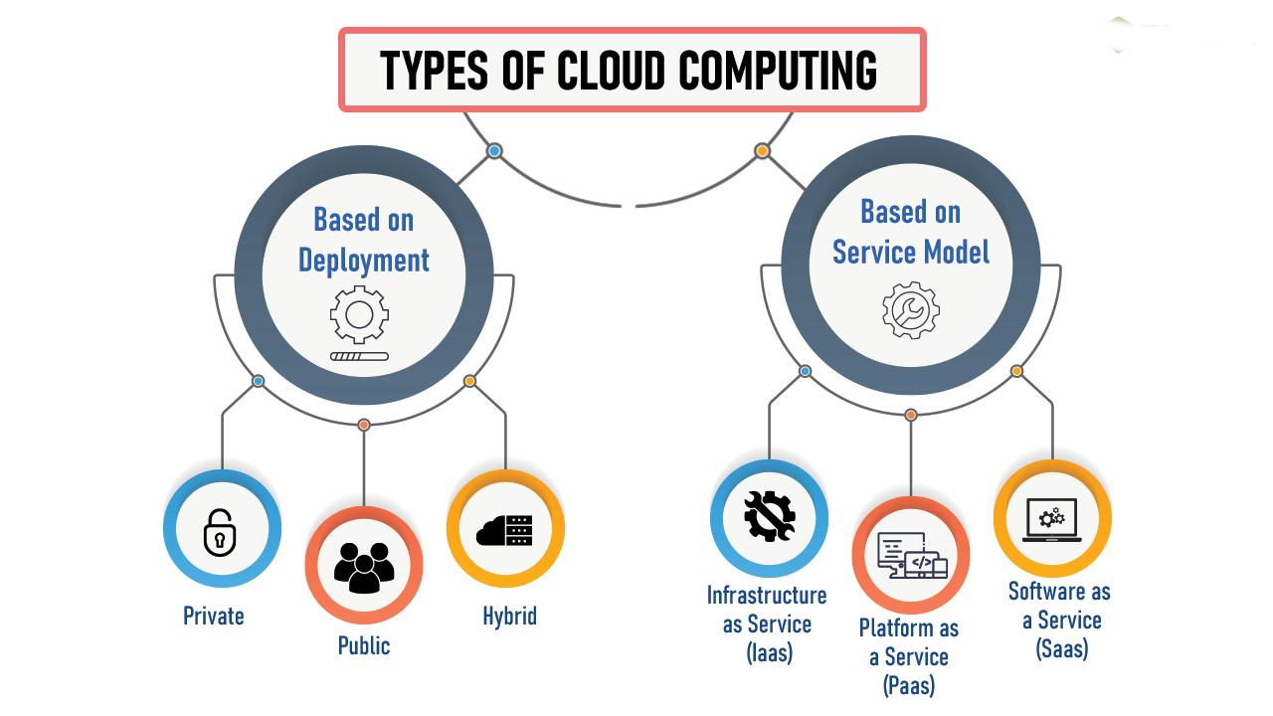
4

Slide 5
Based Deployment Model :
Infrastructure as a Service (IaaS):
"This provides basic building blocks such as virtual machines, storage, and networking. AWS, Google Cloud, and Microsoft Azure are the most common IaaS providers.
"Example: "If you need a virtual server to host an application, IaaS providers allow you to rent this infrastructure and scale it as needed.“
Platform as a Service (PaaS):
"PaaS allows developers to build and manage applications without worrying about the underlying infrastructure. Providers offer a platform where apps can be developed, run, and managed.
"Example: "Google App Engine allows developers to deploy web applications without handling the physical servers or networks."

Slide 6
Software as a Service (SaaS)
"This delivers software applications over the internet. Users don’t need to install or maintain the software; they can simply access it through a browser.
"Example: "Popular SaaS platforms include Google Workspace, Microsoft Office 365, and Salesforce."

Slide 7
Benefits Of Cloud Computing :
Scalability
Cost Saving
Security
Reliability
Accessibility
Notes:
Cost savings : Cloud computing eliminates the need for organizations to purchase and maintain expensive hardware and software, as well as the cost of IT staff to manage them. Cloud computing services are usually delivered on a pay-as-you-go basis, which means users only pay for the resources they use.
Scalability : Cloud computing enables organizations to easily scale up or down their computing resources based on changing business needs.
Accessibility: Cloud computing enables organizations to access their data and applications from anywhere with an internet connection, making it easy for employees to work remotely and collaborate with colleagues in different locations.
Security : Cloud service providers invest heavily in security measures and regularly update them to ensure that their customers' data is secure. This means that organizations can benefit from state-of-the-art security measures without having to invest in them themselves.
Reliability : Cloud computing offers high levels of reliability and uptime, as cloud service providers use redundant infrastructure and backup systems to ensure that their services are always available.
Innovation : Cloud computing enables organizations to quickly experiment with new technologies and services without the need for significant upfront investments. This can help organizations stay competitive and agile in a rapidly changing business environment.

Slide 8
Cloud Deployment Models
Public Cloud:
"These services are available to the general public over the internet, and resources are shared among many users. Popular providers include AWS, Microsoft Azure, and Google Cloud.
"Example: "Netflix uses AWS public cloud to manage their massive content delivery to users worldwide."
Private Cloud
"In this model, cloud resources are used exclusively by a single organization, either hosted on-site or through a private third-party provider.
"Example: "Banks and other industries handling sensitive information often use private clouds to ensure higher security."

Slide 9
Cloud Use Cases and Industry Impact
Healthcare: Medical institutions use cloud systems to store patient records and even analyze large datasets for disease prediction.
Education: Cloud-based tools enable remote learning, collaboration, and storage of academic resources.
E-commerce: "Companies use cloud services to scale their online stores during high traffic events like Black Friday.

Slide 10
Thank You ..
| By Navdip Chothani
10

